Slide 1
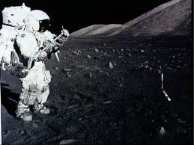
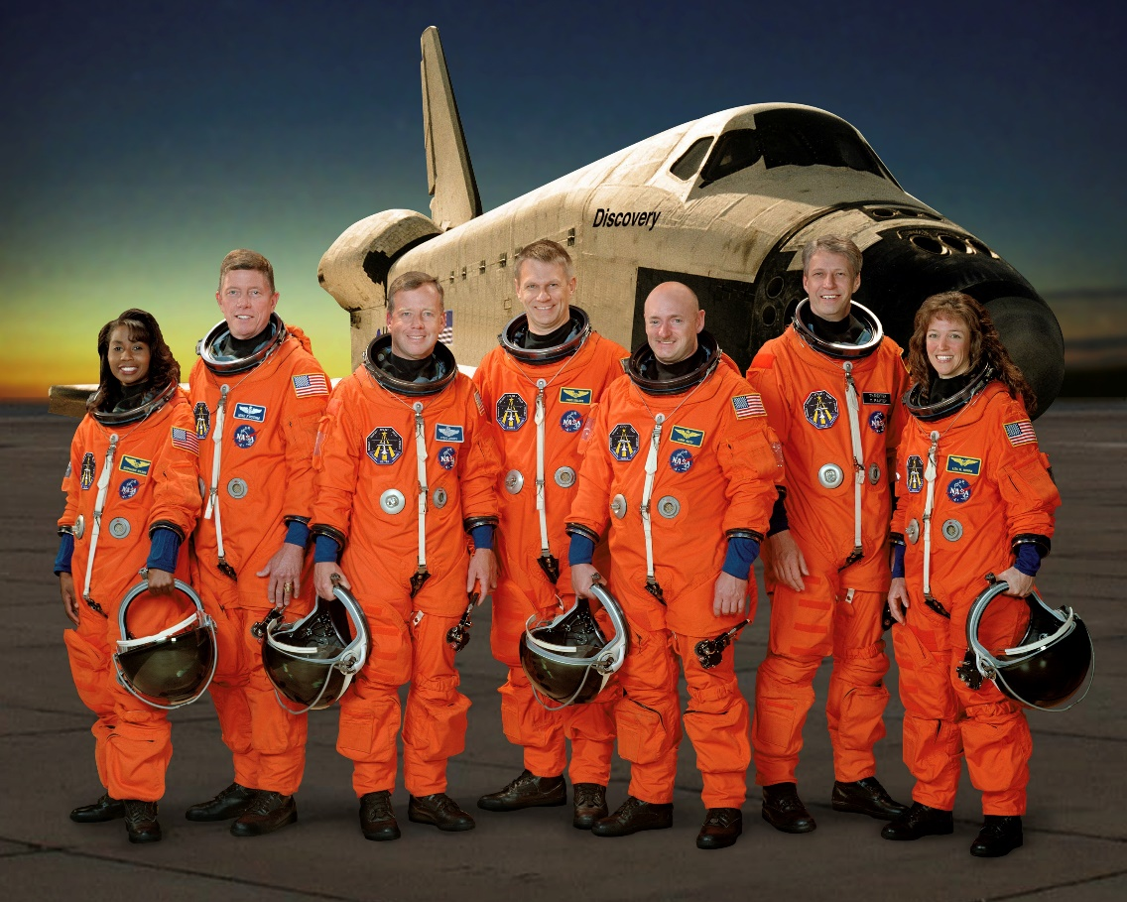
The psychological aspect Group Dynamics SHELl model

Slide 2
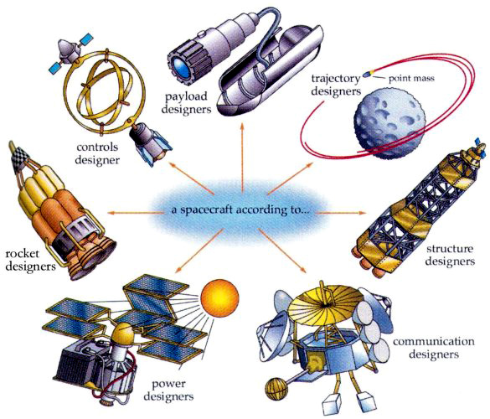
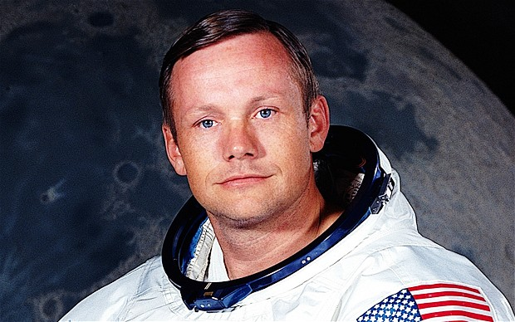
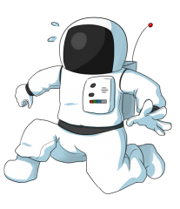
Psychology of spaceflight
HUMANS ARE MORE FLEXIBLE THAN WE THOUGHT!
People are the most important subsystem!

Slide 3
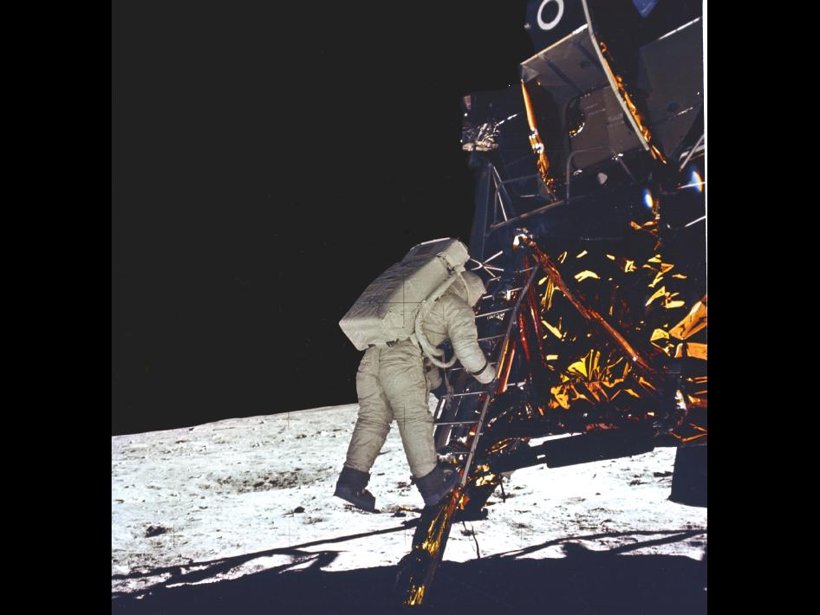
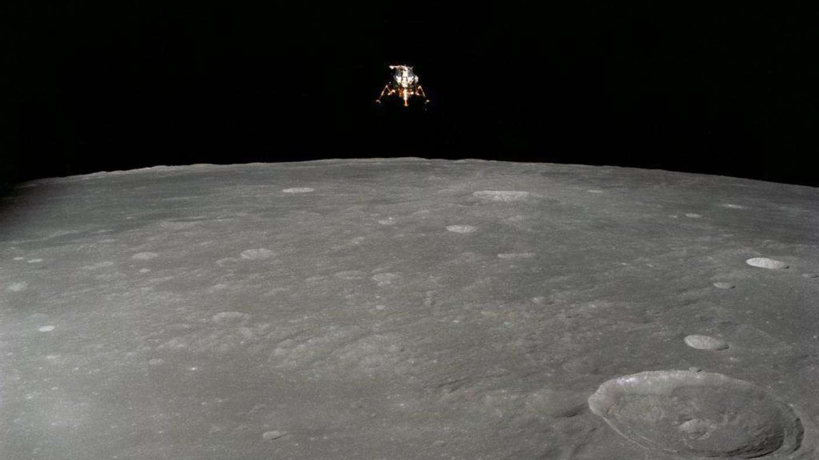
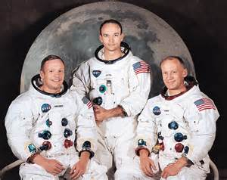
Apollo 11

Slide 4
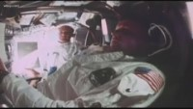

Slide 5
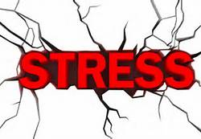
A physical, chemical, or emotional factor that causes bodily or mental tension and may be a factor in disease causation
Merriam-Webster
A condition or feeling experienced when a person perceives that demands exceed the personal and social resources the individual is able to mobilize.
American Institute of Stress

Slide 6
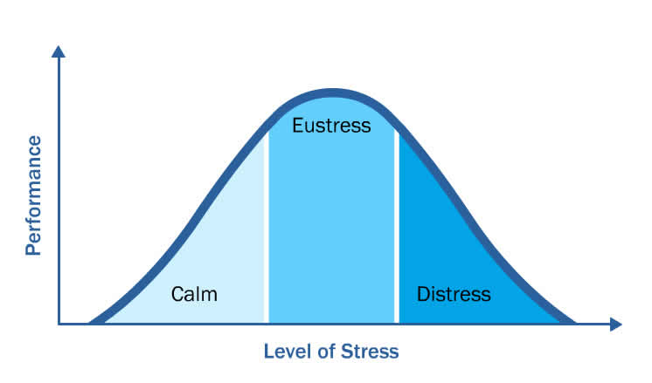
Stress
People’s response to stressors. It is reflected in physiological states, emotion, and activities.
Harrison

Slide 7
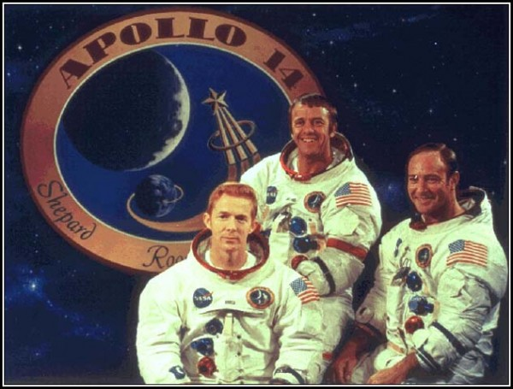
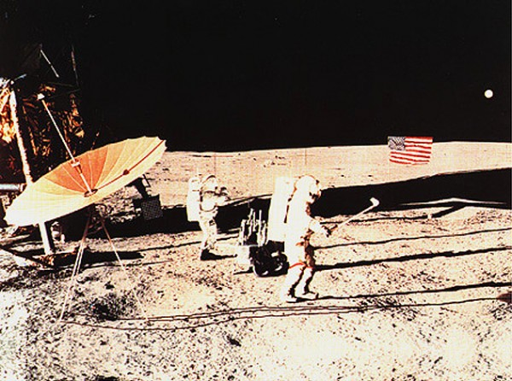
Psychological design
#1 Need a strong link to mission goals

Slide 8
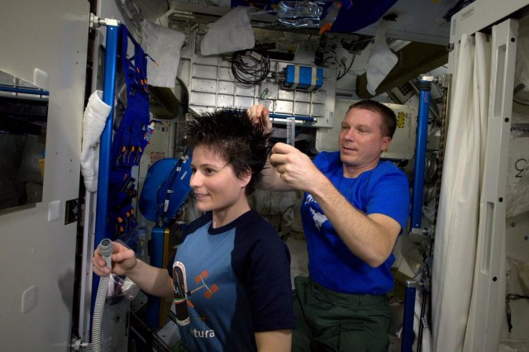
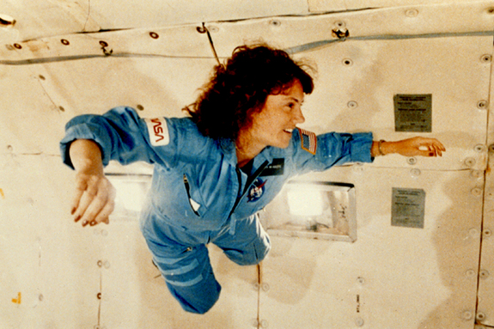
Psychological design
Prevention and Optimization - Psychologists do 80% of their work before a mission begins

Slide 9
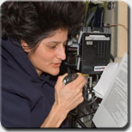
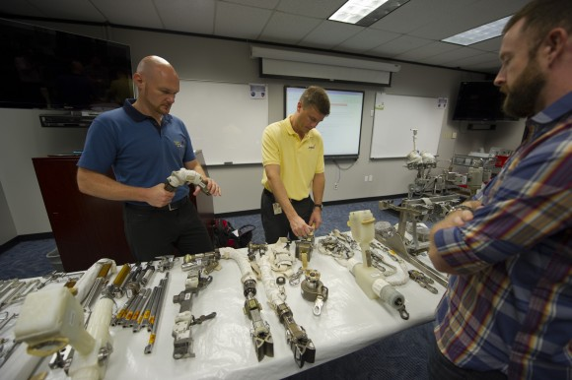

Psychological design
#3 Integrated systems approach
Organizational conditions
Flight environment
Crew

Slide 10
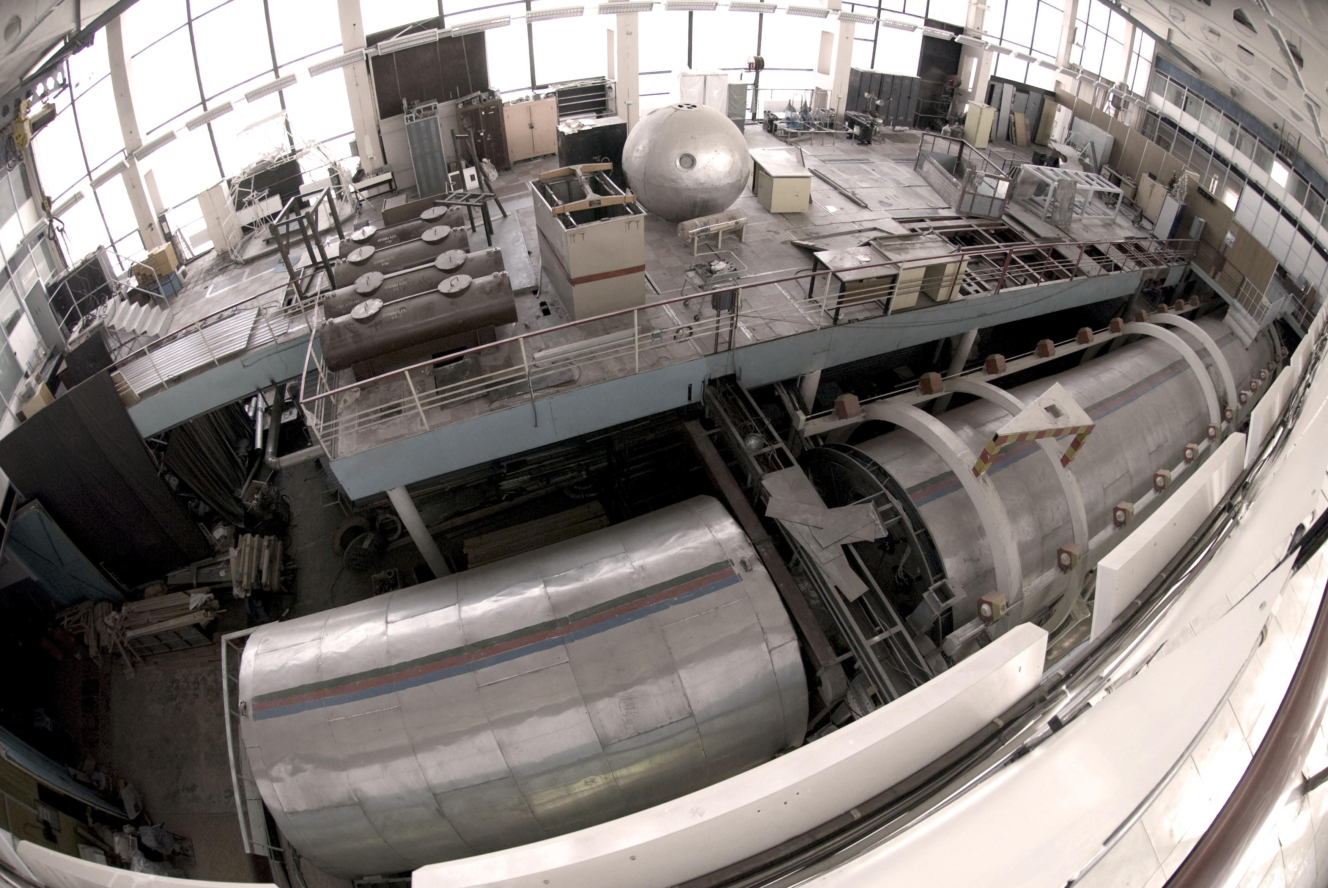
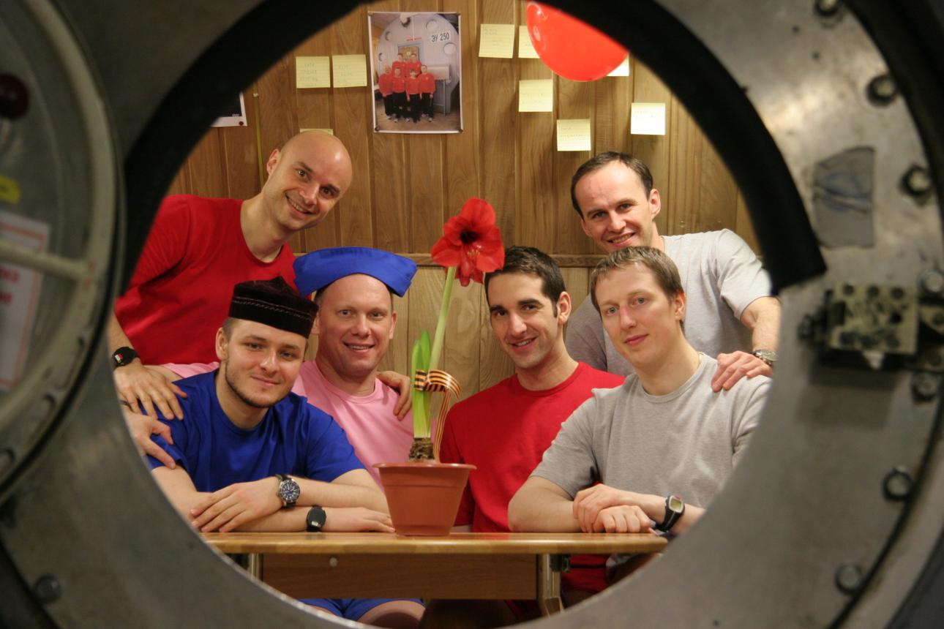
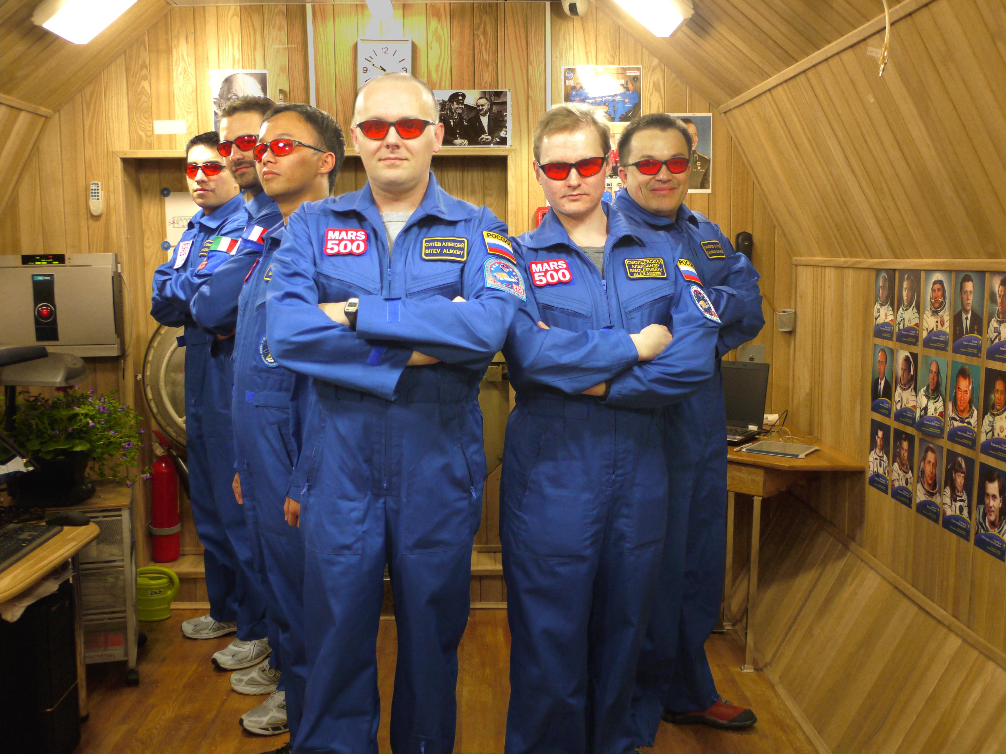
EXAMPLE – MARS 500

Slide 11
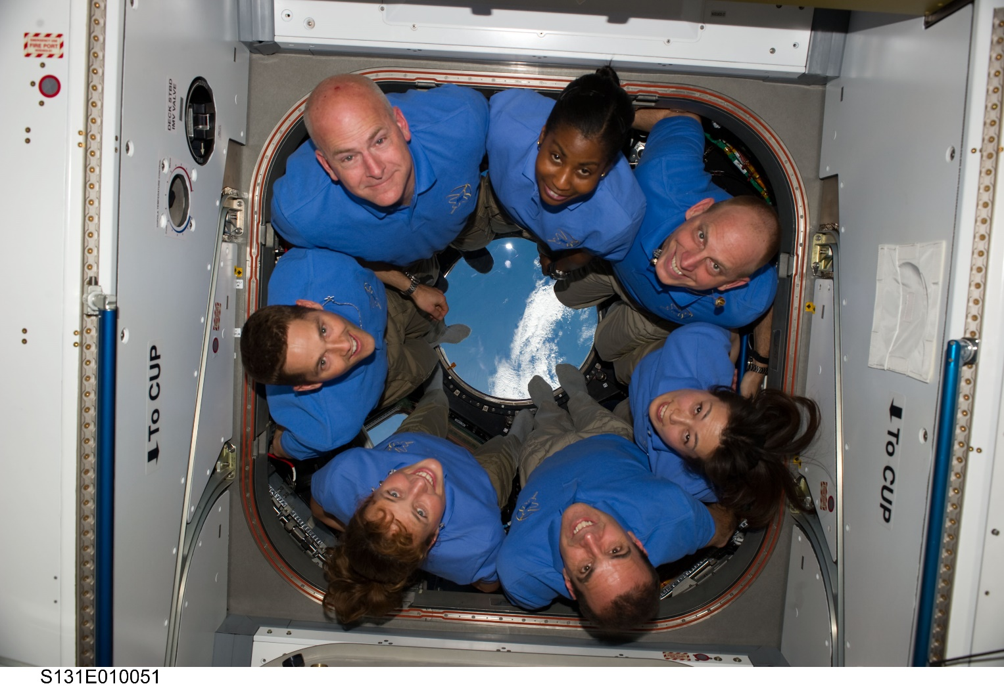
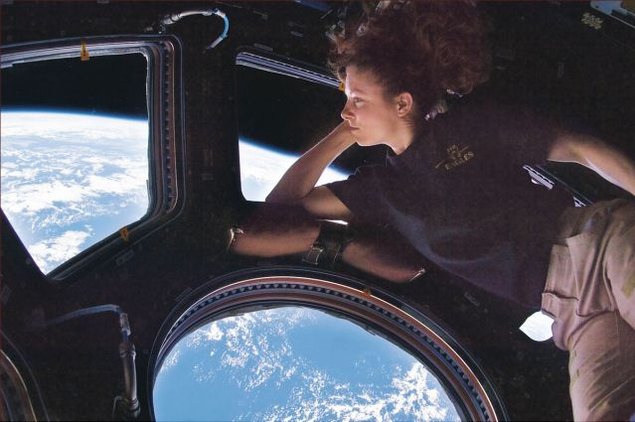
Psychological design
#4 Linkages and Knowledge

Slide 12
Interpersonal Stressors
One result of space travel was that I had become much more philosophical, at times unable even to focus on minor problems back on Earth because they just seemed so small in comparison to what I had experienced and the places I had been. My fellow astronauts who went to the Moon encountered varying degrees of the same disease; we broke the familiar matrix of life and couldn't repair it.
Eugene Cernan (The Last Man on the Moon: Astronaut Eugene Cernan and America's Race in Space)

Slide 13
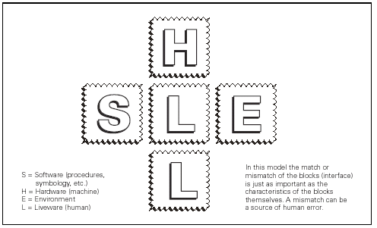
THE SHELL MODEL

Slide 14
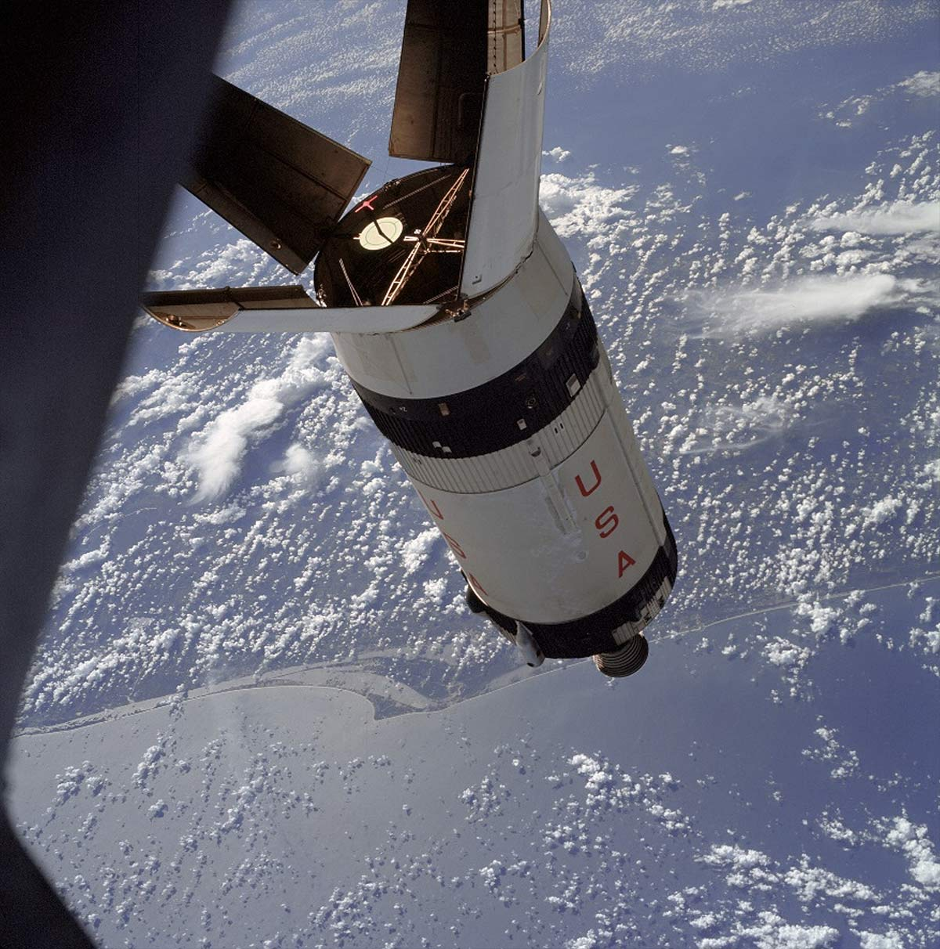
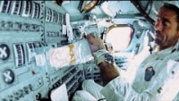
Apollo 7

Slide 15
SHELL MODEL AS APPLIED TO APOLLO 7

Slide 16
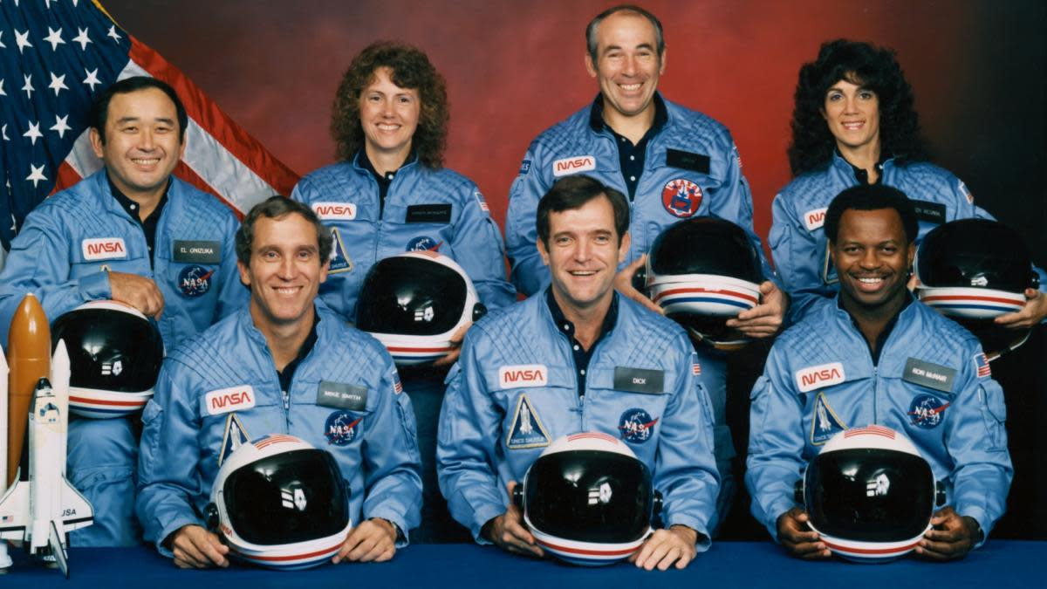
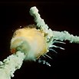
CHALLENGER

Slide 17
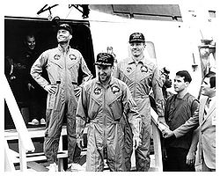
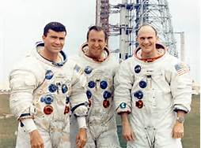
Apollo 13

Slide 18
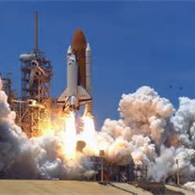
Columbia 2003

Slide 19
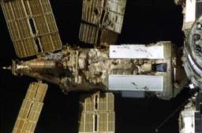
What happened? Progress/mir collision 1997

Slide 20
Shell model as applied to progress/mir collision

Slide 21
SUMMARY

Slide 22
REFERENCES
Beginning Spacecraft Design. 18 January 2015. Beginning Spacecraft Design.
Howell, Elizabeth. 21 August 2013. “Don’t Panic: How Space Emergency Astronaut Training Works.” Universe Today.
McNally, Victoria. 2 January 2015. “ISS Astronaut Samantha Cristoforetti Shows Us How She Gets Haircuts In Space.” The Mary Sue.
NASA. 23 July 2012. International Space Station Reference - Ham Radio.
Prigg, Mark. 23 January 2015. “Asteroid to pass so close on Monday you'll be able to see it with binoculars - but don't panic, Earth's closest call until 2027 poses no threat 'for the foreseeable future.‘” Daily Mail. Read more: http://www.dailymail.co.uk/sciencetech/article-2924110/Asteroid-set-pass-close-Monday-ll-able-binoculars-Earth-s-closest-call-2027-poses-no-threat-foreseeable-future.html#ixzz3Pnyxn6aw Follow us: @MailOnline on Twitter | DailyMail on Facebook
Siegel, Ethan. 2 October 2010. “Could You Really Hit a Gold Ball Miles and Miles and Miles on the Moon?” Science Blogs.

